Slide 1
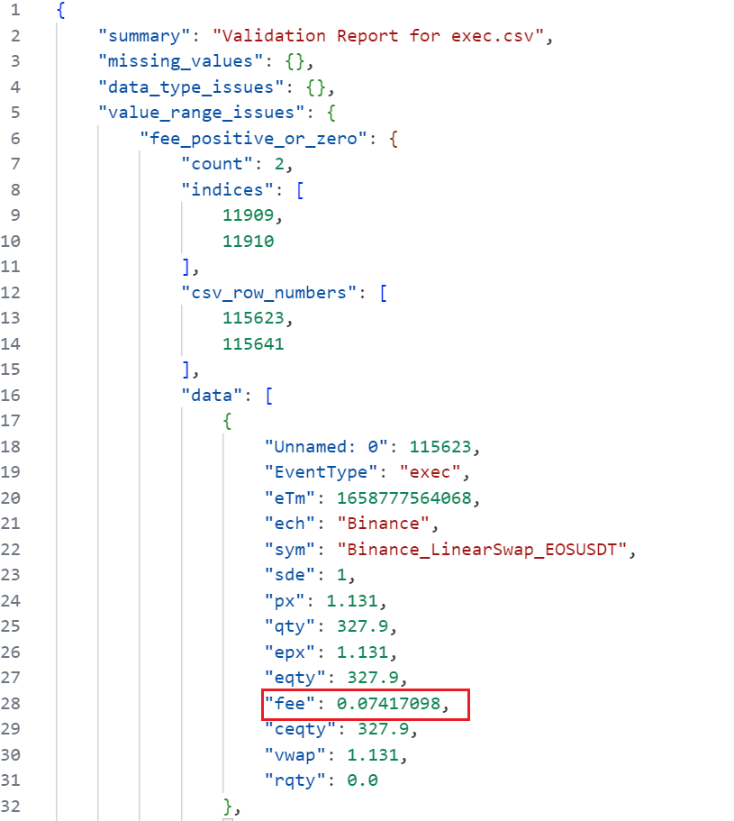
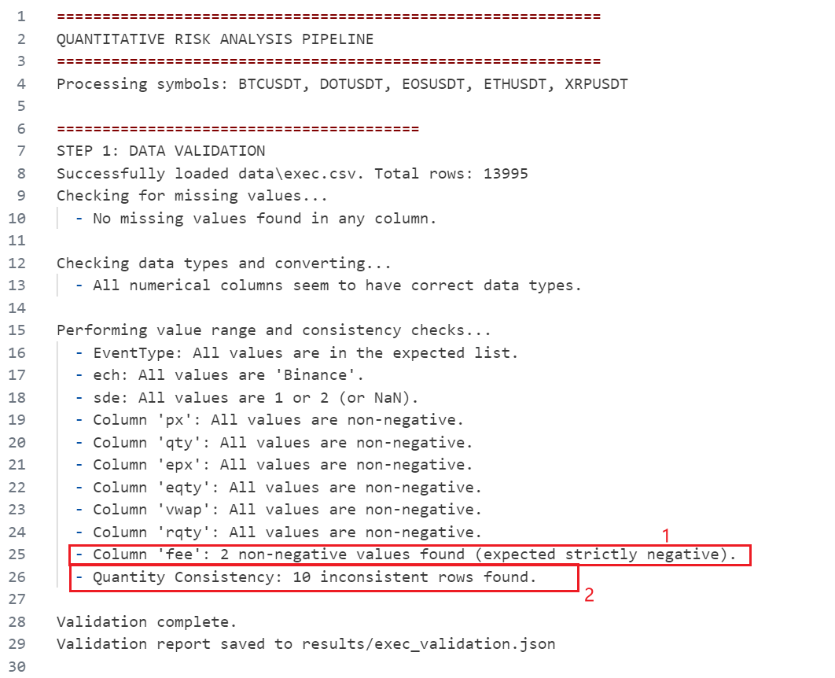
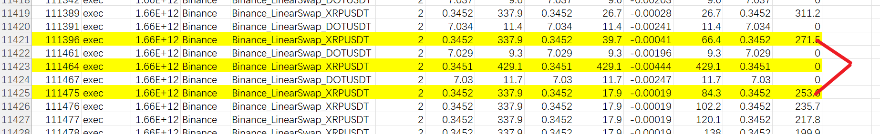
Step 1. Data validation
Check execution record integrity
Identified 2 executions with a positive transaction fee.
Identified 10 executions where quantity (qty) does not equal (executed quantity (eqty) + remaining quantity (rqty)
Results to JSON with timestamp and trade detail:
Abnormal Order Analysis: Order IDs 111396 and 111475 should represent the same order. However, an intermediate order with a different price was inserted. This suggests a potential missing cancellation order (cnl order) or edit order.

Slide 2
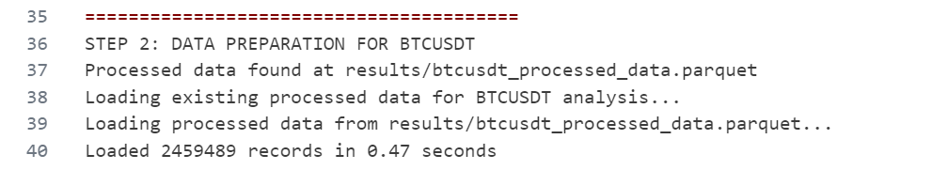
Step 2. Data merge
Aligning market data with the next Nearest execution record

Slide 3
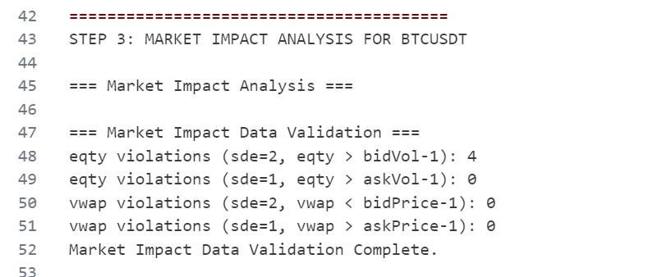
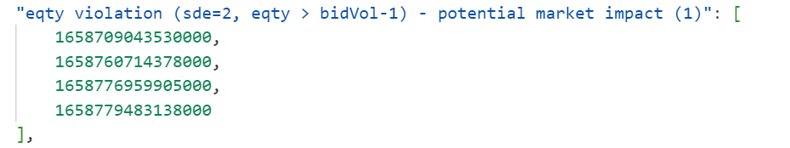
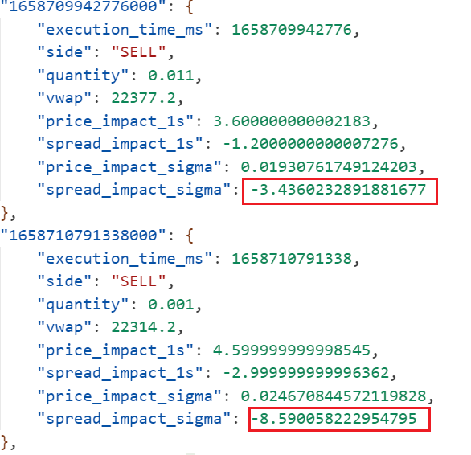
Step 3. Market impact
Analysis of Large Sell Executions: Identified 4 sell executions with volumes exceeding bidvol - 1, potentially impacting the bid-ask spread and market price.
Trade Filtering for Outliers: Trades exhibiting a price or spread impact (within 1 second) beyond 1.5 standard deviations (sigma) are filtered out. For example:

Slide 4
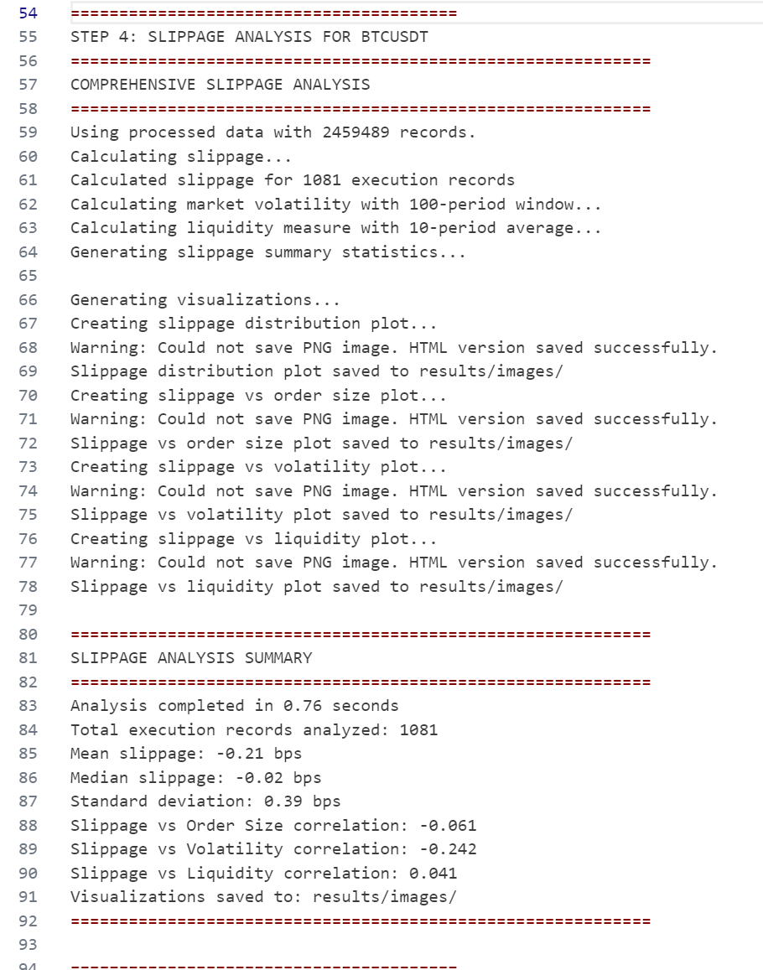
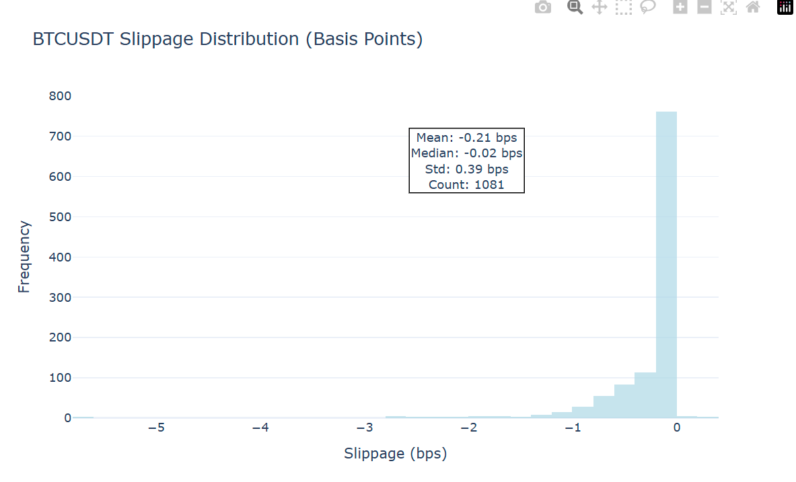
Step 4. Slippage
Slippage distribution analysis and market correlation testing
Correlation Plots (See Next Slide)
Note on Image Export: PNG images were not saved due to a version mismatch between kaleido and plotly. This issue can be resolved by creating a new virtual environment (venv) with compatible versions.

Slide 5
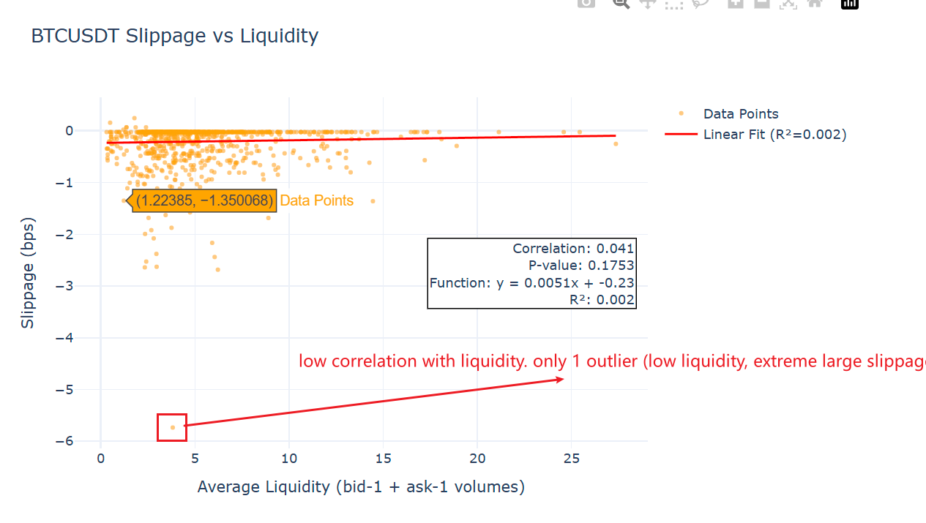
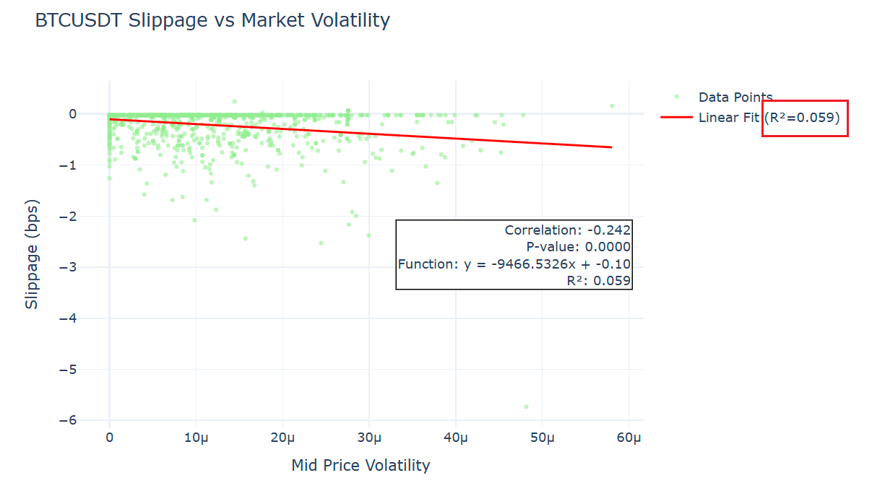
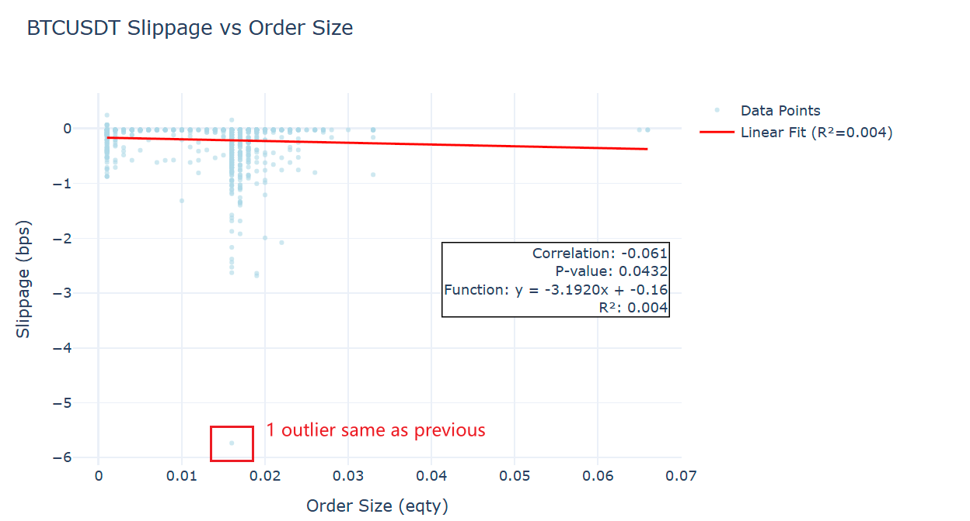
Step 4. Slippage
High-Risk Execution Identified: A single high-risk execution was identified, exhibiting low correlation with overall market movements.

Slide 6
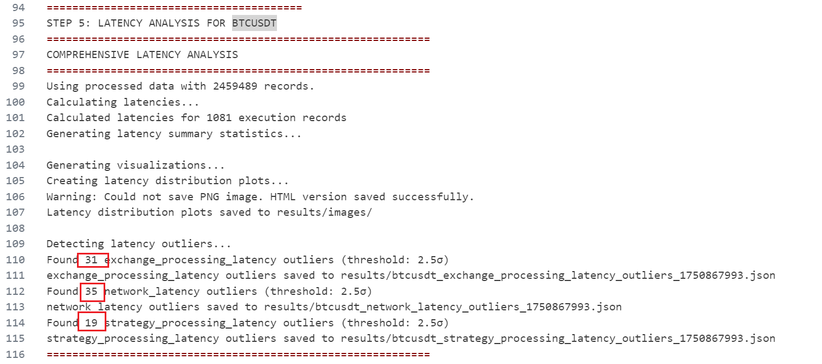
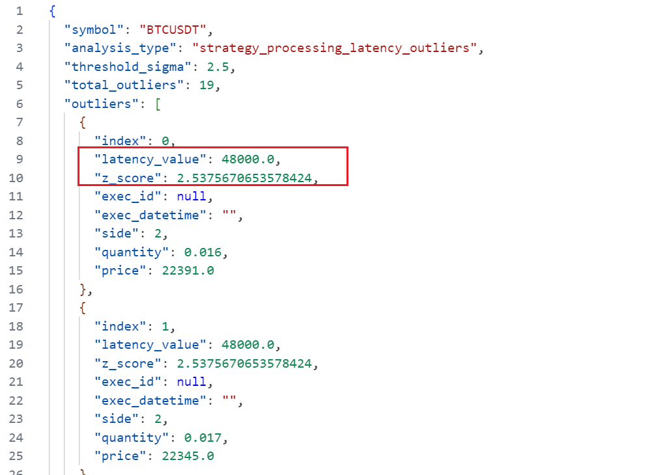
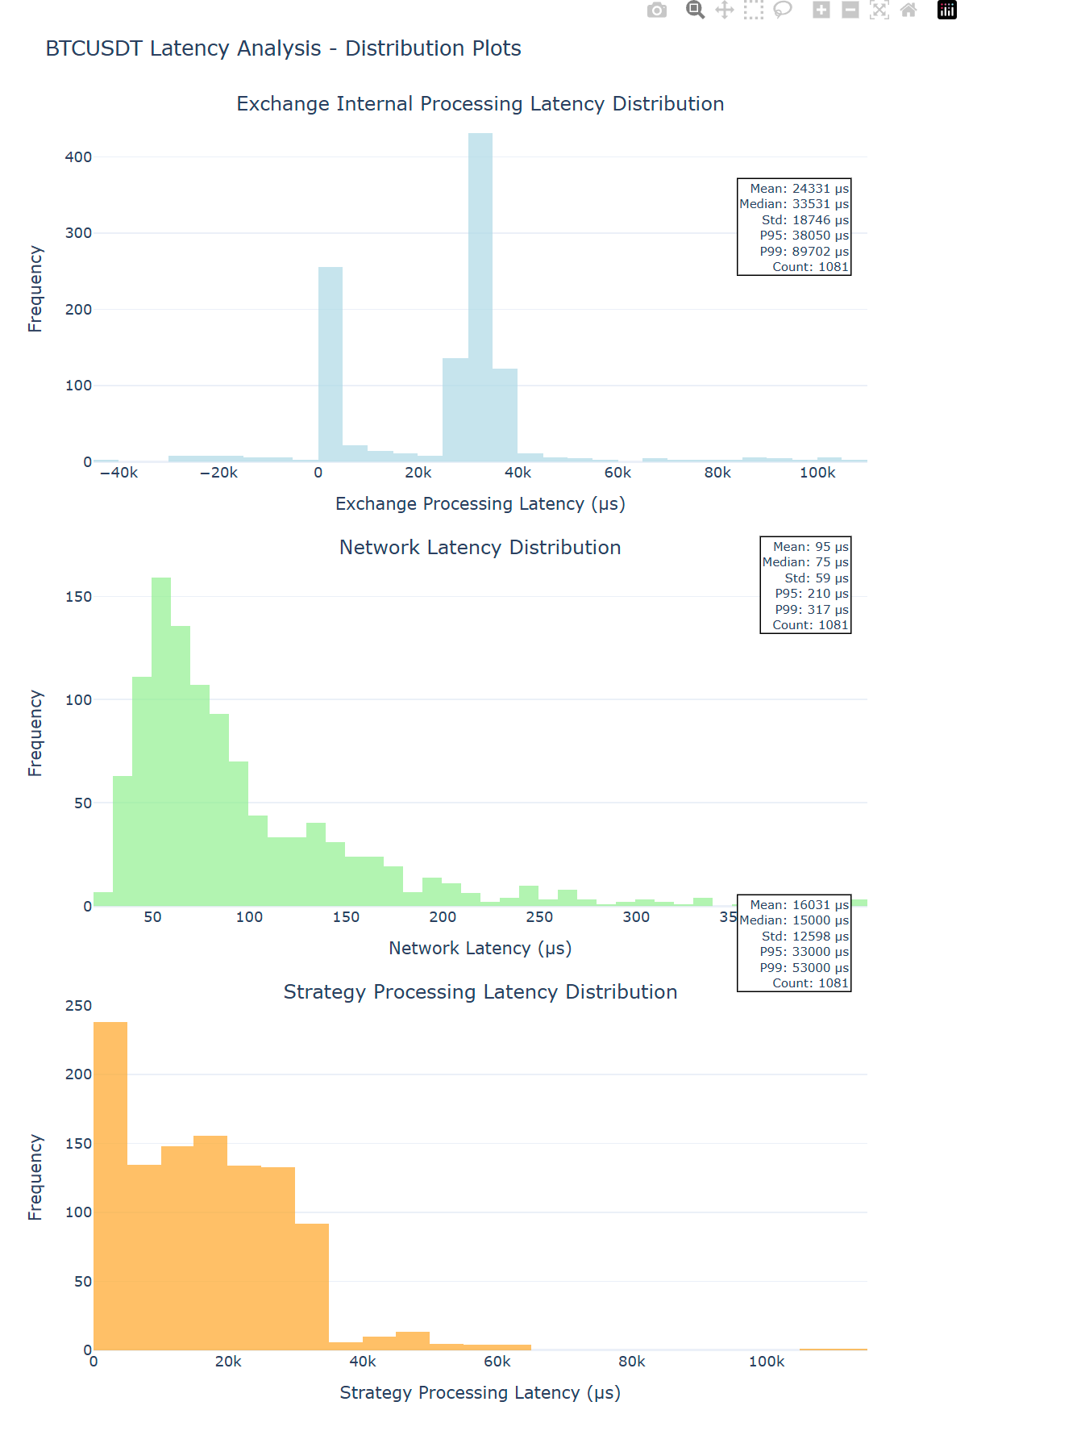
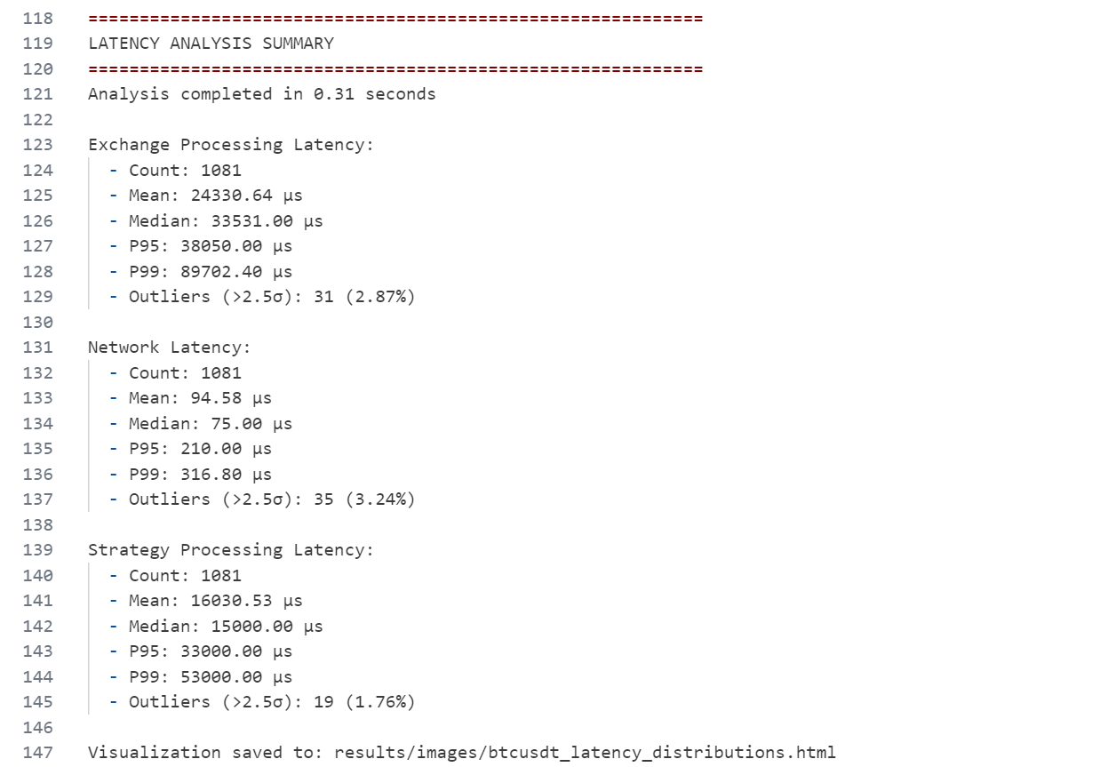
Step 5. Latency
Latency Measurement: Calculation of exchange, network, and strategy latencies, with examples provided in JSON format.
Outlier Identification: High-latency outliers are identified when exceeding 2 standard deviations (sigma) from the mean.

Slide 7
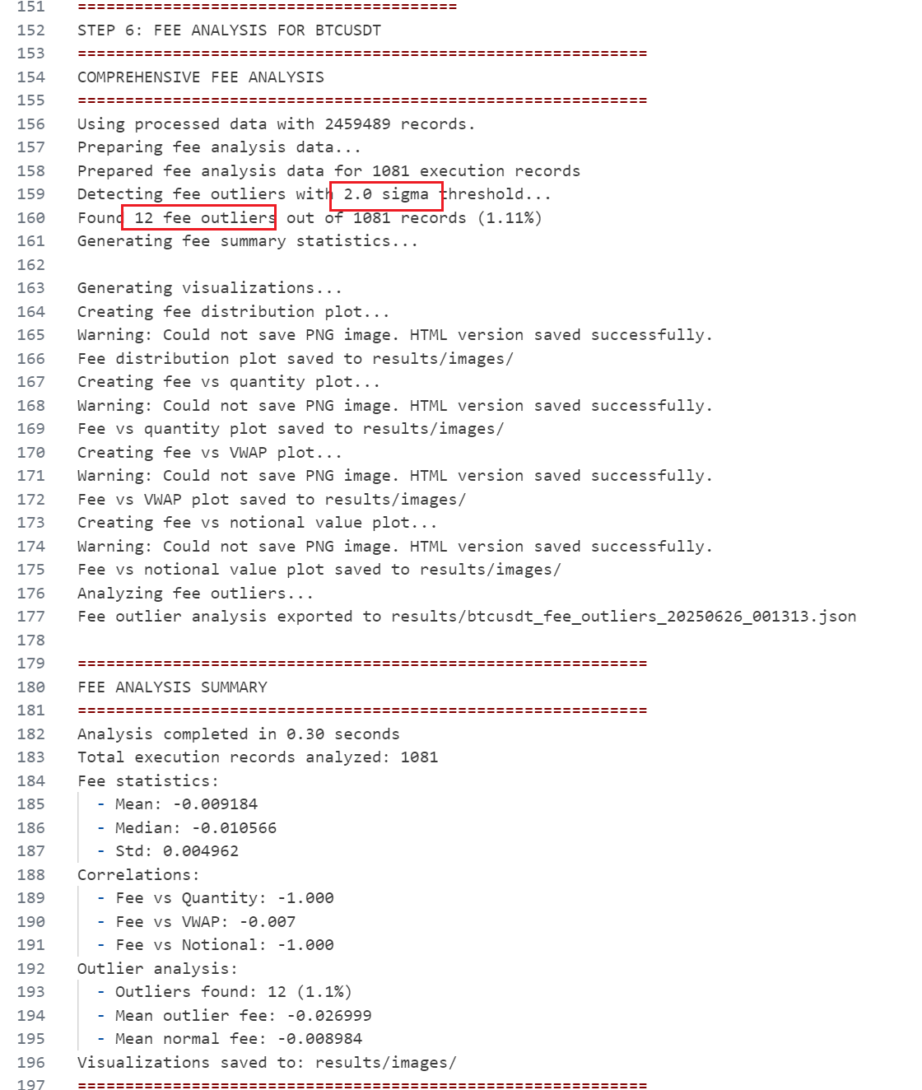
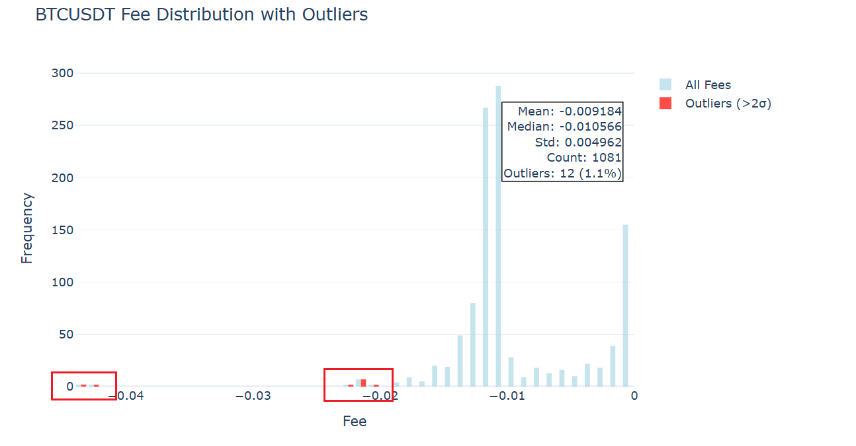
Step 6. Fees analysis
Analysis of Exceptional Fees: Calculation of exceptionally high fees and assessment of their correlation with volume or price
Correlation Results (See Next Slide)

Slide 8
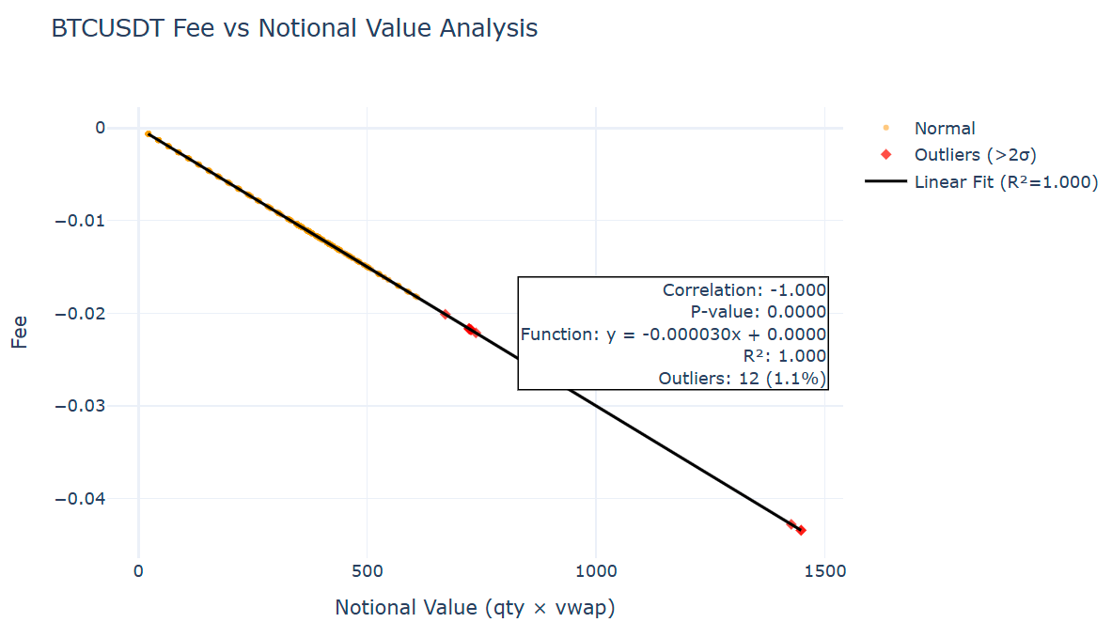
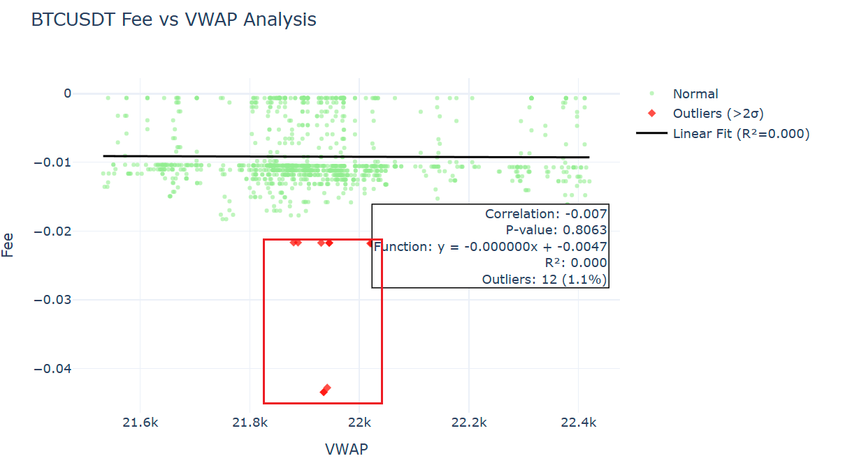
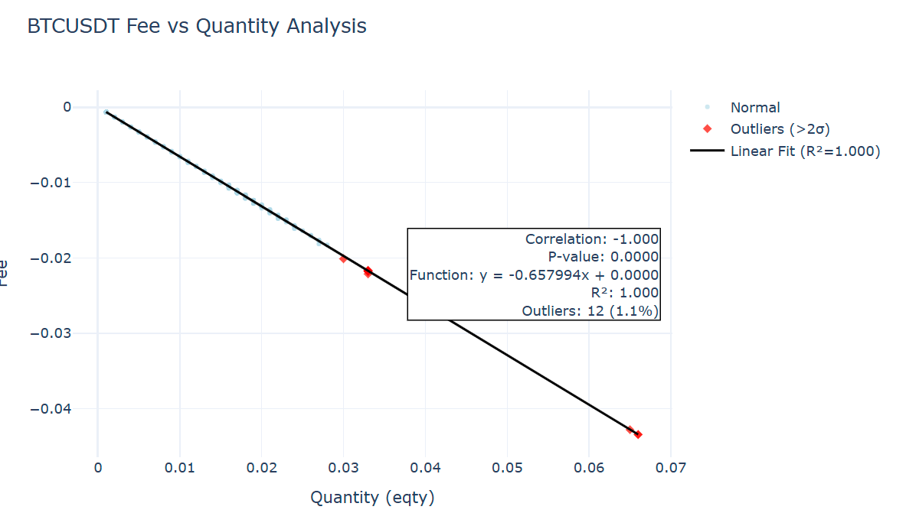
Step 6. Fees analysis
Fee Correlation Summary: Fees are correlated only with volume, showing no correlation with VWAP. While no systematic risk was identified, these 12 specific trades are considered abnormal

Slide 9
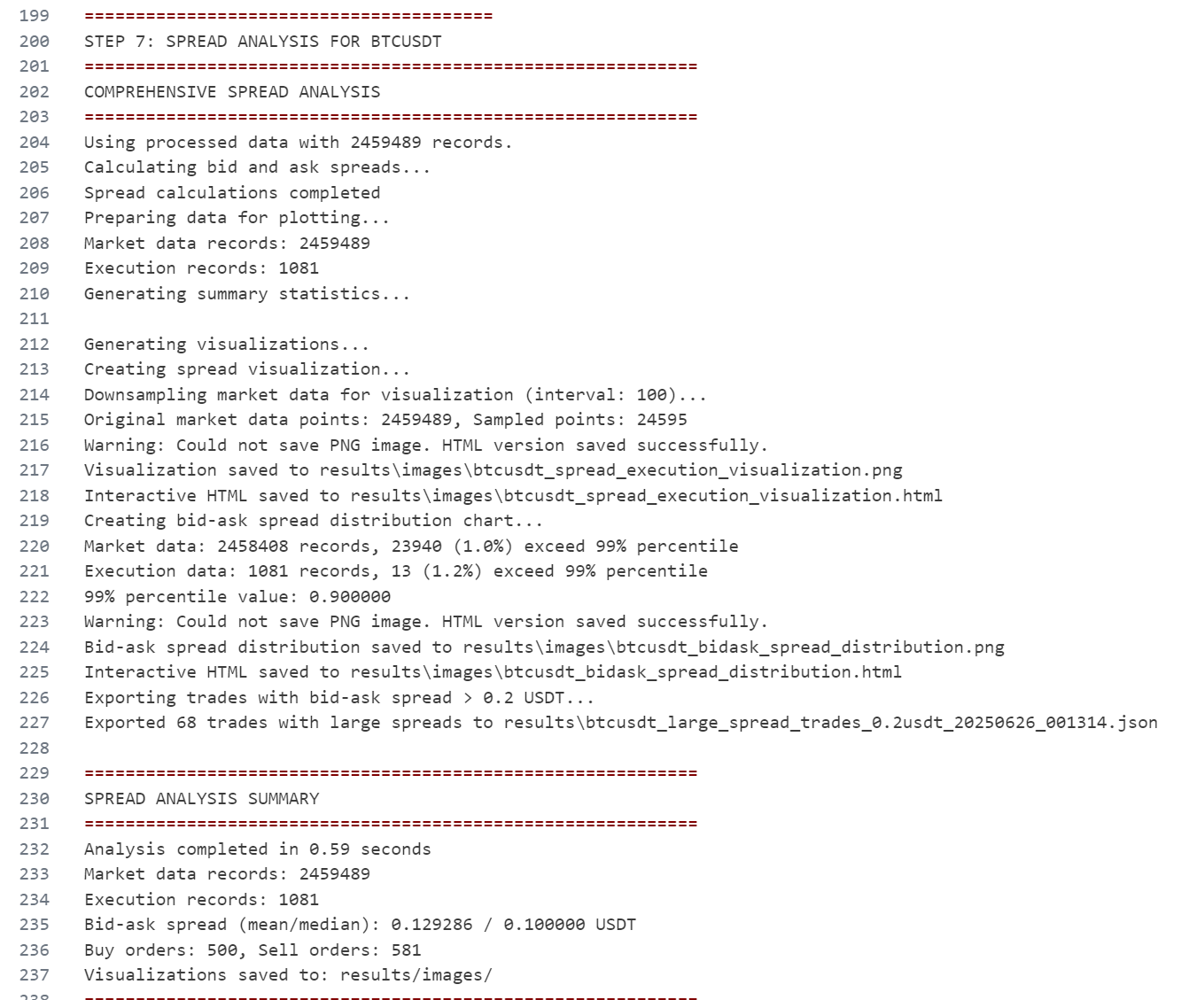
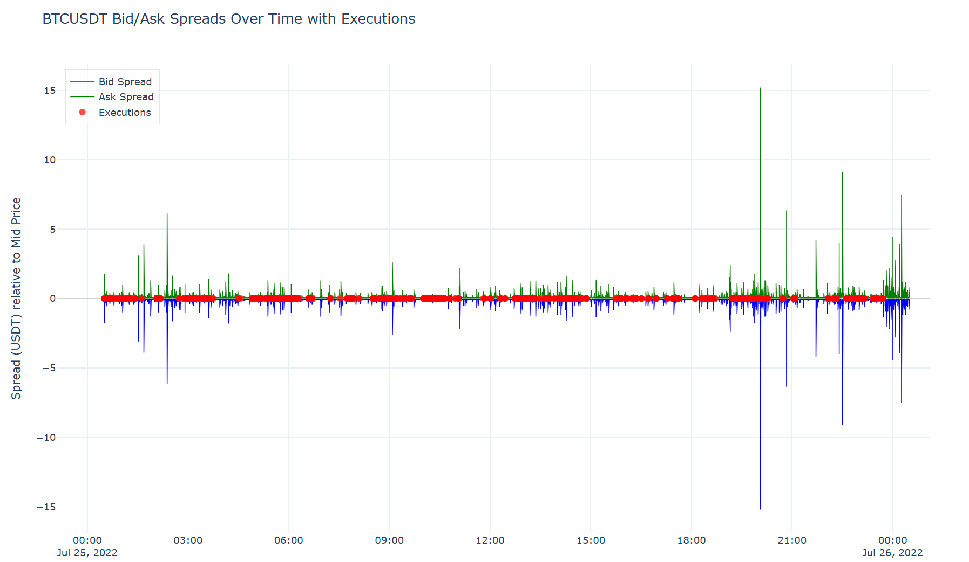
Step 7. Spread analysis
Trade Execution Analysis: The highlighted trade (in red) primarily occurred during periods of low bid-ask spread. Conversely, no trades were observed during phases of large bid-ask spread.
Quantitative Verification: A distribution plot is provided on the next slide for mathematical verification.

Slide 10
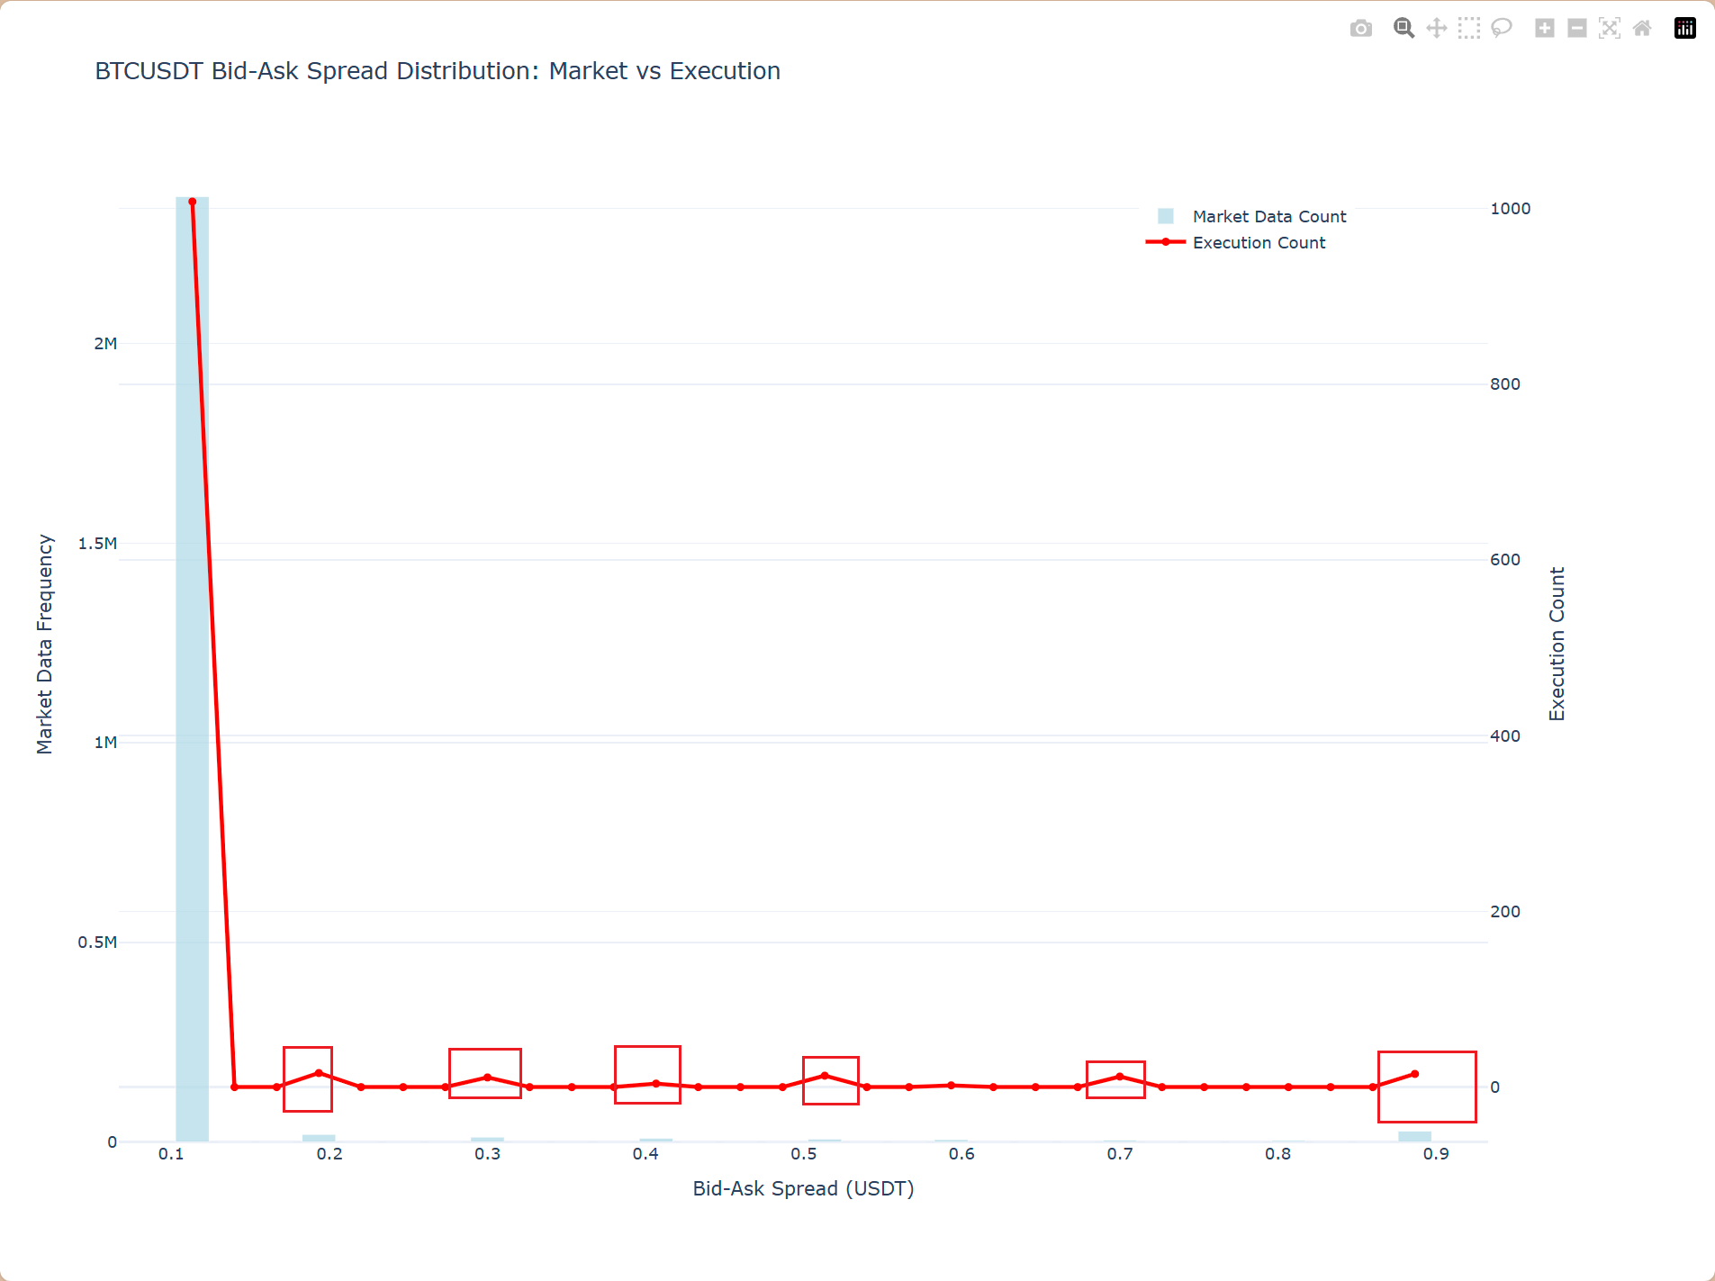
Step 7. Spread analysis
Trade Distribution in Large Spreads: A limited number of trades were still executed during periods of larger bid-ask spreads. For improved clarity and readability, the data points for the 0.9 bin (representing values >0.9) have been combined。

Slide 11
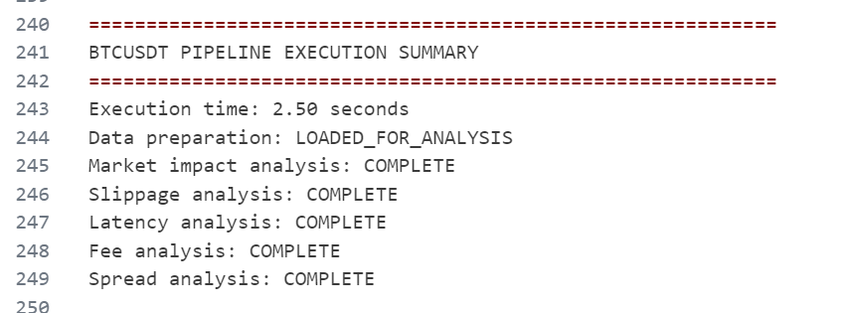
Step 8. Execution Summary

